Slide 1

SRI SAI INSTITUTE OF TECHNOLOGY & SCIENCE Approved by AICTE Delhi,Accredited by NAAC & Affiliated to JNTUA,Ananthapur,Rayachoty,Annamayya dist-516270 AP.
PRESENTED BY:
S.Aneesha 21F71A0551 Under the Guidence of
S.Saniya 21F71A0512 Mr.D.Eswaraiah,M.Tech.,
T.Kavya 21F71A0554 Assistant professor
B.Harshitha 21F71A0508
K.Harika 21F71A0518
S.Arshiya Nowsheen 21F71A0541

Slide 2

IDENTIFYING FRAUDULENT CREDIT CARD TRANSACTIONS USING ENSEMBLE LEARNING

Slide 3
CONTENTS
Abstract
Introduction
Existing System
Drawbacks of Existing System​
Proposed System
Advantages of Proposed System
​Algorithms
Code snippet
Modules
Design
Implementation
Tech Stack
Testing
Screenshots
Conclusion
Future Enhancement

Slide 4

ABSTRACT
Credit card fraud has become a growing concern with the increasing use of digital payments.
This project aims to leverage ensemble learning techniques to improve the detection of fraudulent credit card transactions.
This study explores the applications of various ensemble techniques, to identify fraudulent credit card transactions.

Slide 5

INTRODUCTION
Credit card fraud involves unauthorized use of credit cards to obtain funds or goods.
Traditional fraud detection methods often struggle with the high volume of transactions and low occurrence of fraud.
Advanced machine learning techniques, particularly Ensemble Learning, have emerged as effective solutions for improving fraud detection accuracy.
This project explores ensemble learning techniques to identify fraudulent transactions more accurately.

Slide 6

EXISTING SYSTEM
Name
ENSEMBLE LEARNING
METHODS BAGGING: Reduces variance by training multiple models on different subsets of data. BOOSTING: This process will help in boosting the performance of the last classifiers. STACKING: Combines classifiers to find an improved model.
Ensemble Learning is a machine learning technique that combines predictions from multiple models (referred to as base learners or weak models) to improve overall performance and achieve better accuracy than any individual model.

Slide 7
DRAWBACKS
High false positives
High False Negatives (Missed Fraud)
Lack of explainability
Data privacy and Security Risks
Scalability Issues
Risk of overfitting

Slide 8

PROPOSED SYSTEM
The proposed system aims to improve the accuracy, efficiency, and robustness of fraud detection by combining multiple machine learning models through Ensemble Learning.

Slide 9

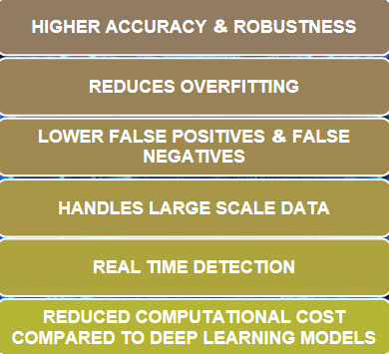
ADVANTAGES OF PROPOSED SYSTEM
ADVANTAGES OF PROPOSED SYSTEM

Slide 10
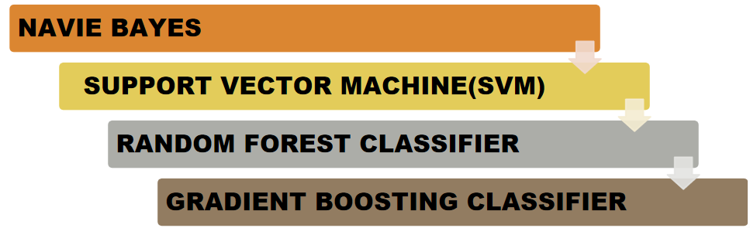
ALGORITHMS
ALGORITHMS

Slide 11
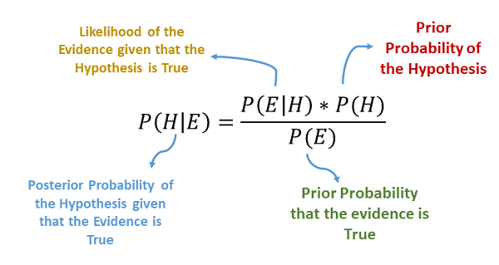
NAVIE BAYES CLASSIFIER
Naive Bayes (NB) is a probabilistic machine learning algorithm based on Bayes' Theorem, which assumes that all features are independent of each other in the given class label.
It performs well in many classification tasks.

Slide 12

SUPPORT VECTOR MACHINE(SVM)
It is a supervised learning that can be used for classification or regression tasks.
In classification tasks, the goal of an svm algorithm is to find the best hyperplane that can separate the data points into different classes.

Slide 13
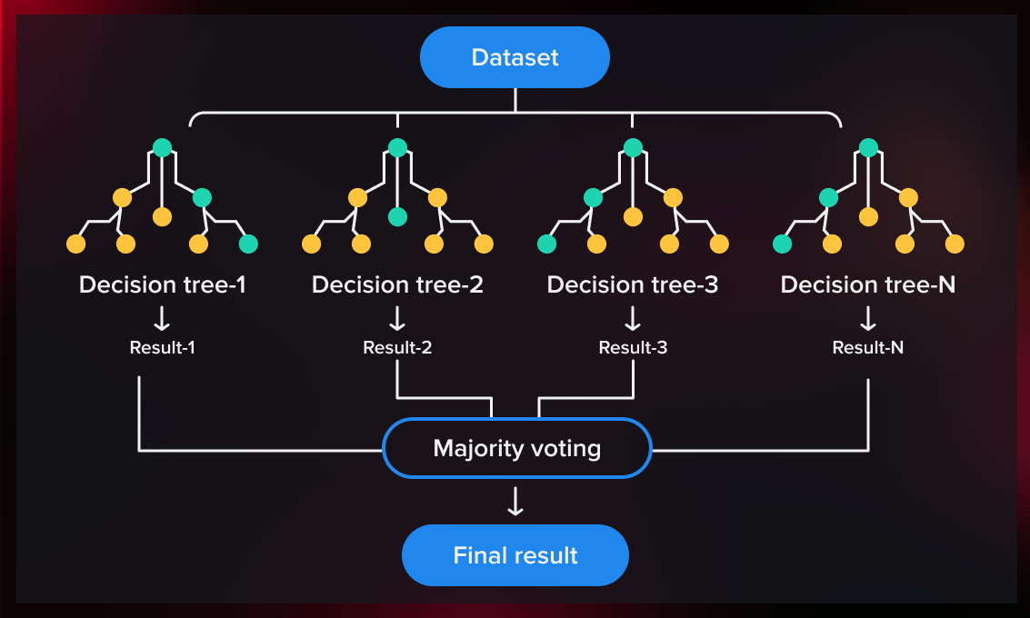
RANDOM FOREST CLASSIFIER
Random Forest is an ensemble machine learning algorithm that builds multiple decision trees during training and combines their predictions to improve accuracy and reduce overfitting.
It works on the principle of Bagging (Bootstrap Aggregating).

Slide 14
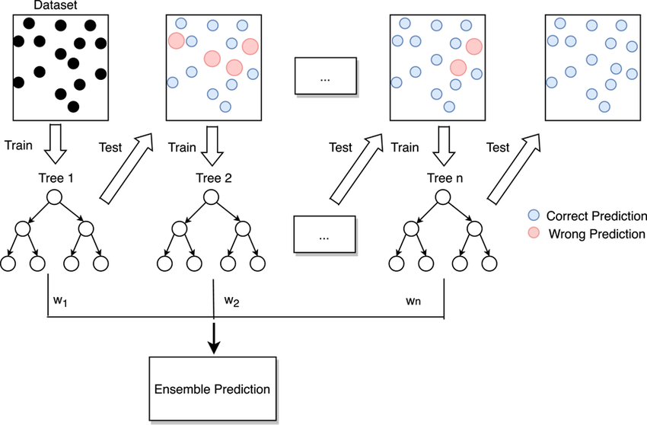
GRADIENT BOOSTING CLASSIFIER
Gradient Boosting Classifier (GBC) is an ensemble machine learning algorithm that builds decision trees sequentially, with each subsequent tree correcting the errors made by the previous ones.

Slide 15
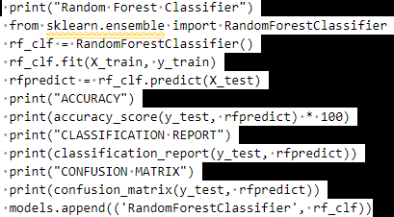
CODE SNIPPET

Slide 16

MODULES
SERVICE
Login with credentials
Train and test dataset
View trained and test accuracy in barchart
View trained and test accuracy results
View detected fraudlent credit card transactions
REMOTE
Register and login
View users profile
ADMIN
View user details
Authorize users

Slide 17
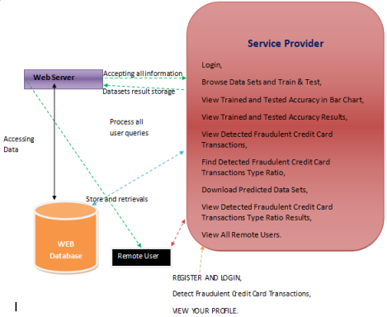
DESIGN SERVER ARCHITECTURE

Slide 18
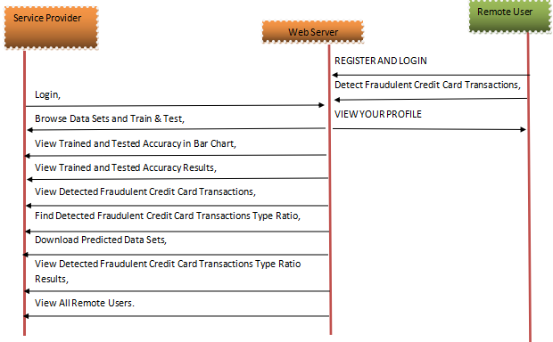
SEQUENCE DIAGRAM

Slide 19

SYSTEM IMPLEMENTATION
The system implementation involves a login page with registration and service buttons.
New users register and proceed to a Profile Page to predict frauds in credit card.
Service providers access an admin page for data analysis using algorithms like navie bayes classifier, svm, random forest, gradient boosting classifier.
Results are displayed in bar charts and pie charts, with options to download data sets and manage users.

Slide 20

TECH STACK
PYTHON
DJANGO
MACHINE LEARNING LIBRARIES
FRONTEND TECHNOLOGIES
DATABASE

Slide 21
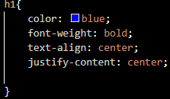
HTML
The foundation for structuring web pages is laid using HTML,defining the content and overall layout
CSS
Cascading Style Sheet(CSS) are used to style the HTML elements,controlling the visual appearance of the system’s interface

Slide 22



Pandas
Python data manipulation powerhouse, simplifying analysis with dataframe tables and seamless integration with NumPy and Matplotlib.
NumPy
Python's numerical computing champ. Handles large arrays ,math functions for speed. Essential for science , data, ML.
Scikit Learn
ML powerhouse in Python. Easy yet effective, with tools for analysis and model building. Built on NumPy, SciPy, Matplotlib. Widely used in academia and industry.

Slide 23
TESTING
Unit Testing: Verifies individual modules for proper functionality and interface consistency.
Integration Testing: Tests integrated software components to build a program structure based on design, using top-down and bottom-up approaches.
User Acceptance Testing: Involves end-users to ensure the system meets functional requirements.
Output Testing: Ensures the system produces the required output in specified formats.
Validation Checking: Validates text and numeric fields for data accuracy and functionality.

Slide 24
MANUAL TESTING
TEST CASE 01
TEST CASE 02
Test Case Name | User Registration
Description | 1) Navigate to the Login Page 2) Click on the “Register" button. 3) Fill in valid registration details. 4) Click on the “ Sign Up” button.
Output | User Should be successfully registered and redirected to the profile page
Test Case Name | Admin Login
Description | 1) Navigate to the Service Provider section. 2) Enter valid admin credentials. 3) Click on the "Login" button.
Output | Admin should be able to log in successfully and access the admin panel.

Slide 25
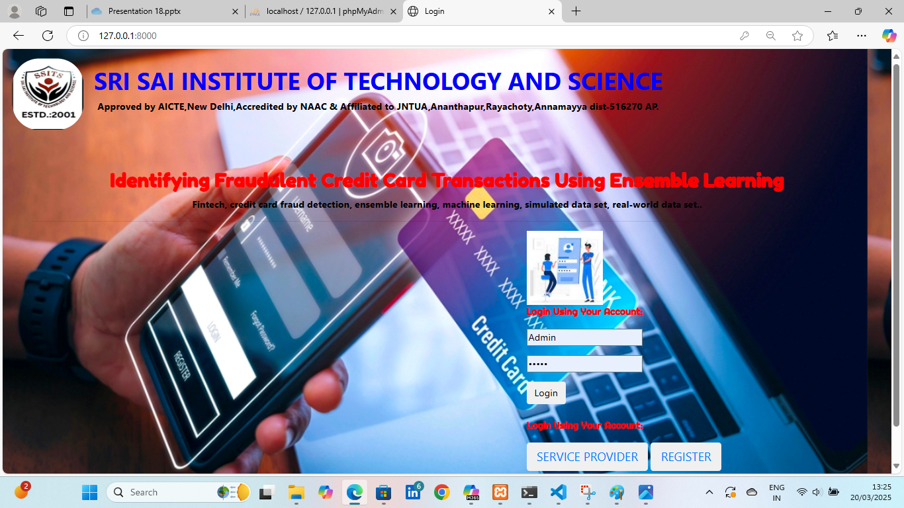
PROJECT SCREENSHOT

Slide 26
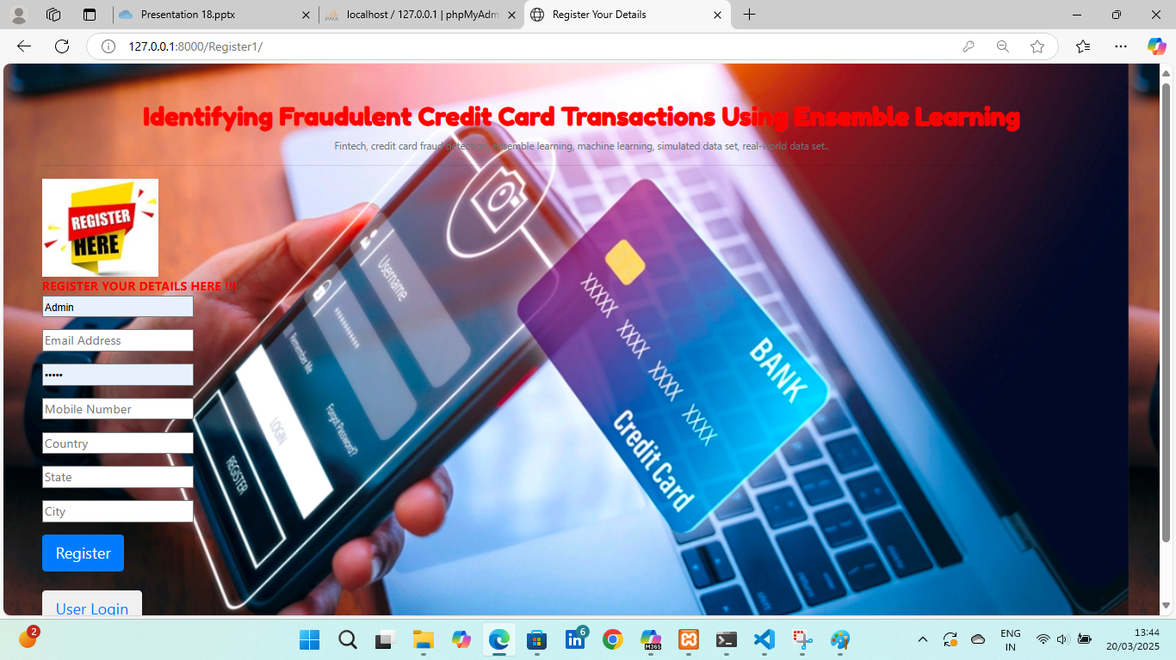
PROJECT SCREENSHOT

Slide 27
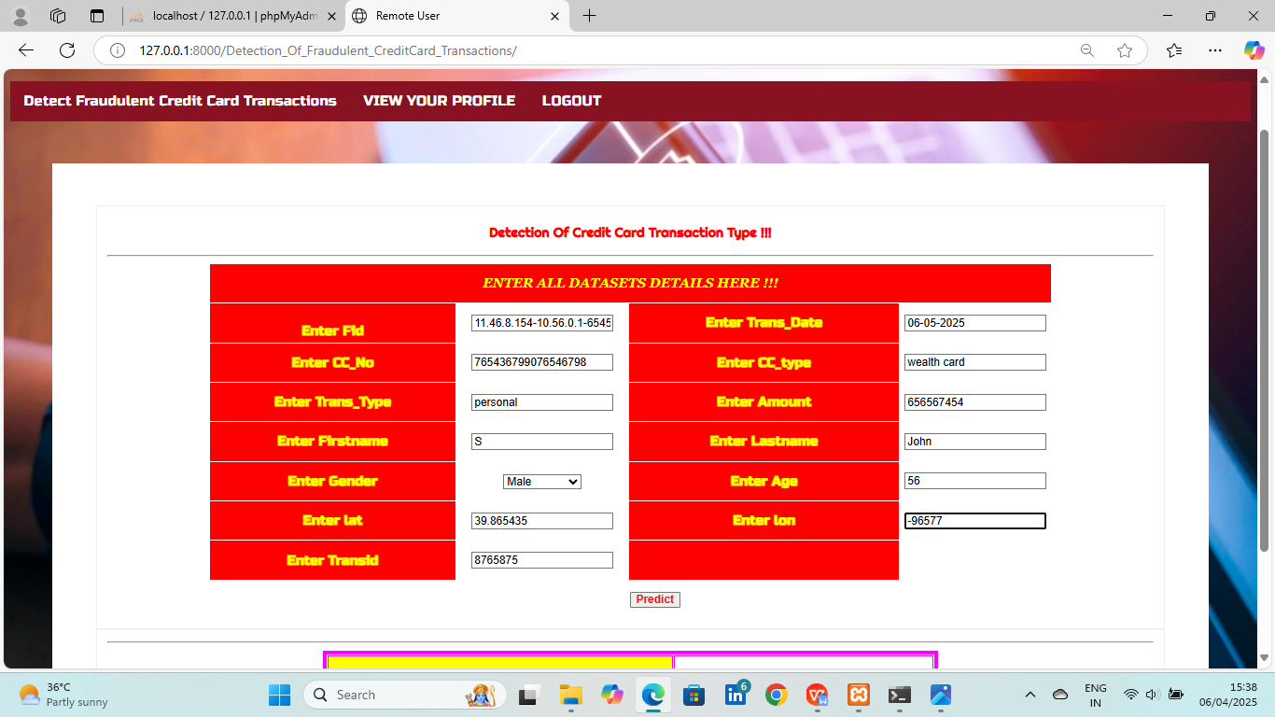
PROJECT SCREENSHOT

Slide 28
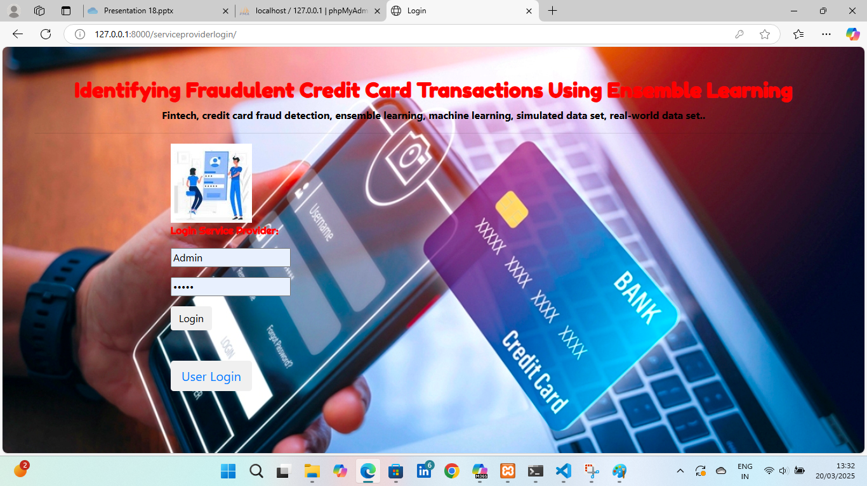
PROJECT SCREENSHOT

Slide 29
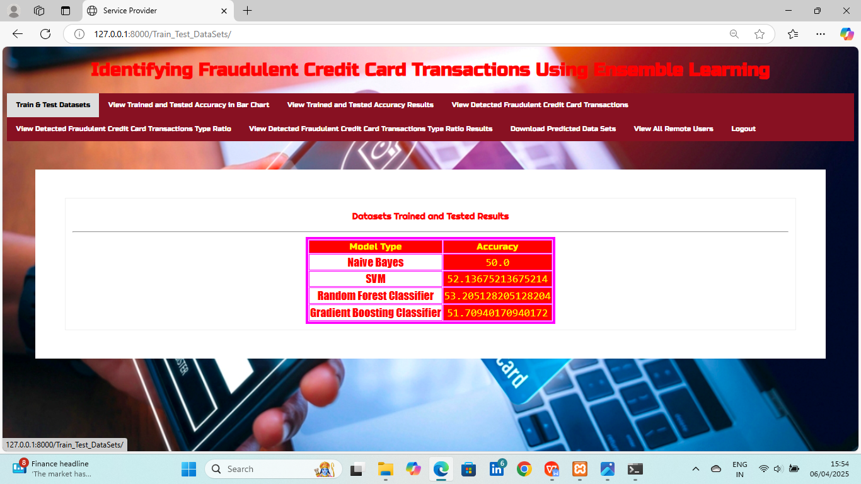
PROJECT SCREENSHOT

Slide 30
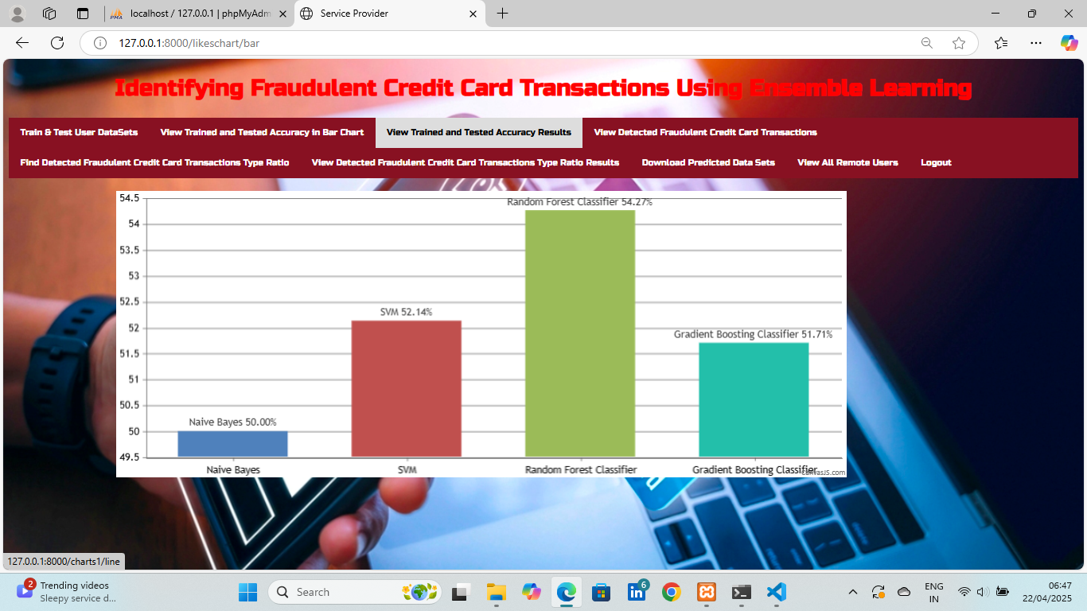
PROJECT SCREENSHOT

Slide 31
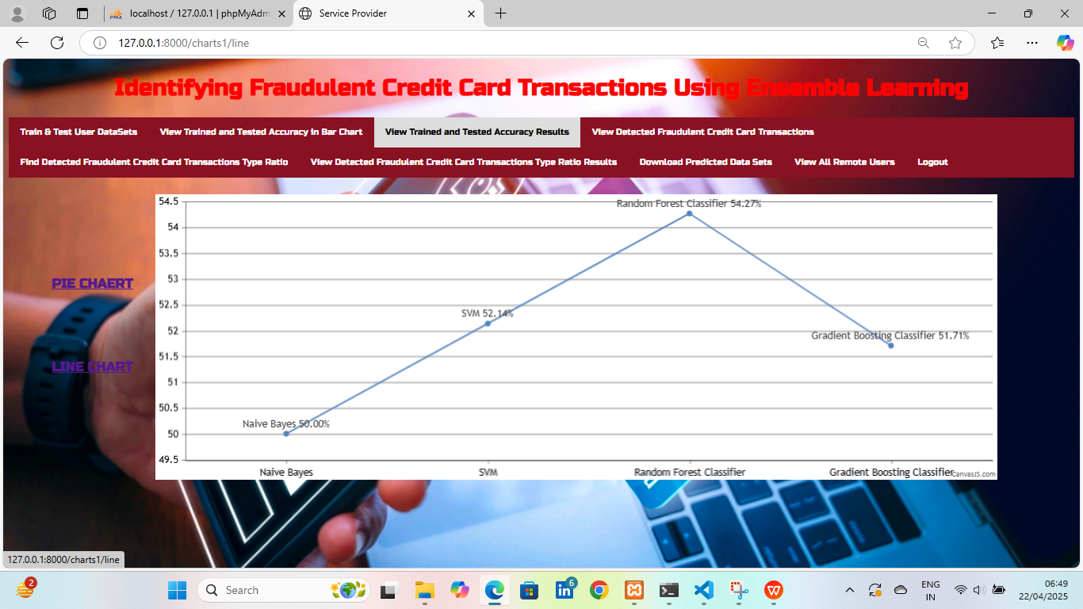
PROJECT SCREENSHOT

Slide 32
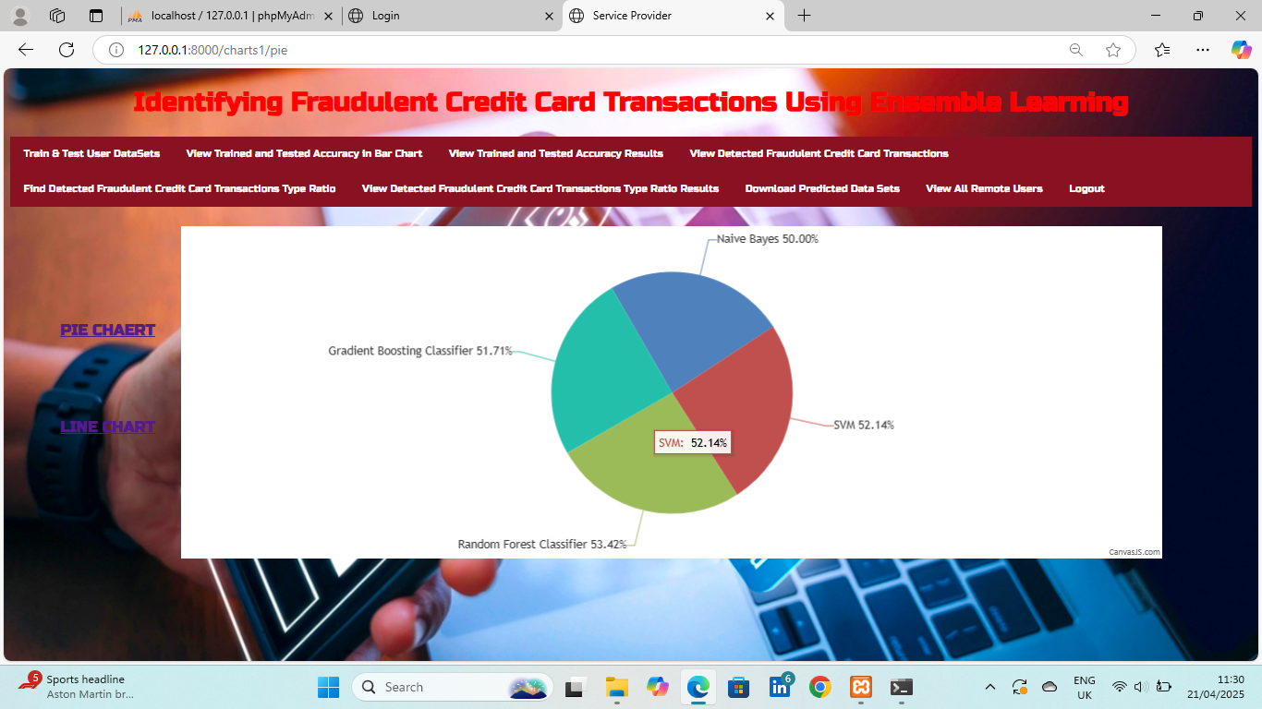
PROJECT SCREENSHOT

Slide 33
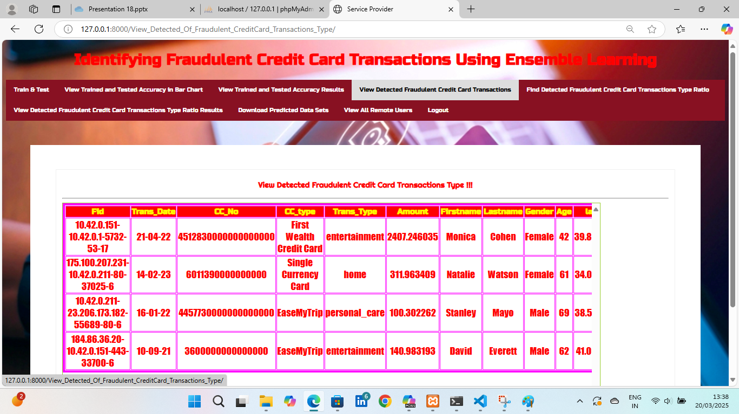
PROJECT SCREENSHOT

Slide 34
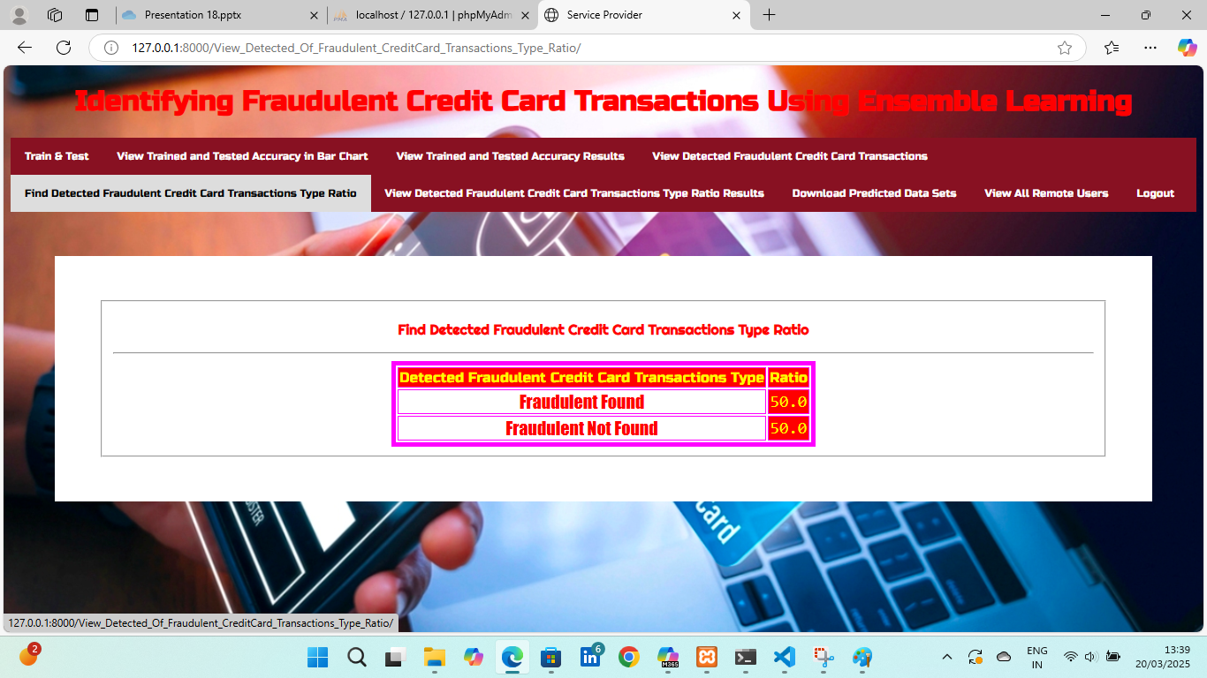
PROJECT SCREENSHOT

Slide 35
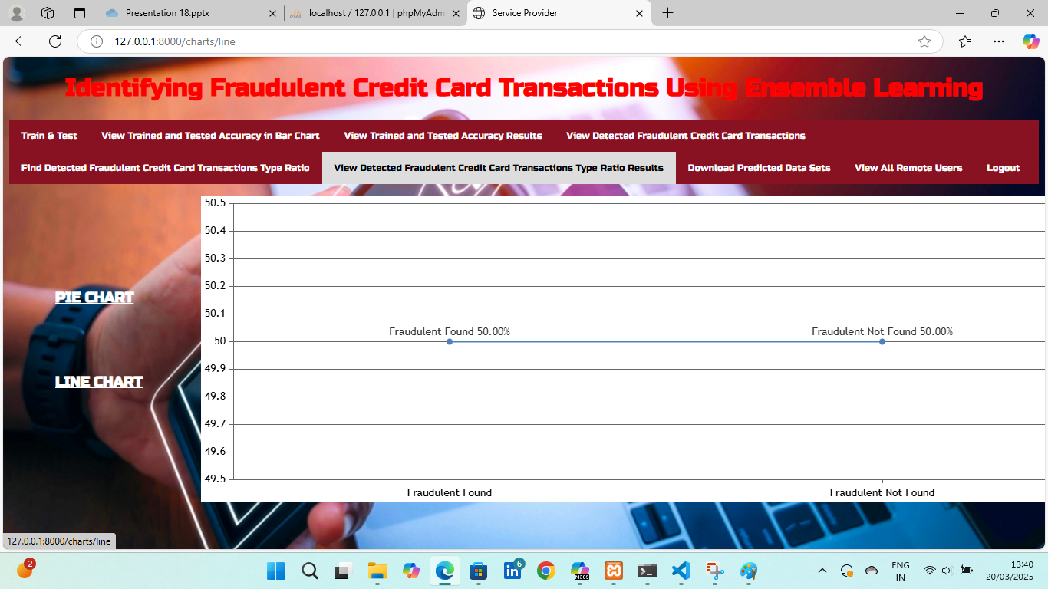
PROJECT SCREENSHOT

Slide 36
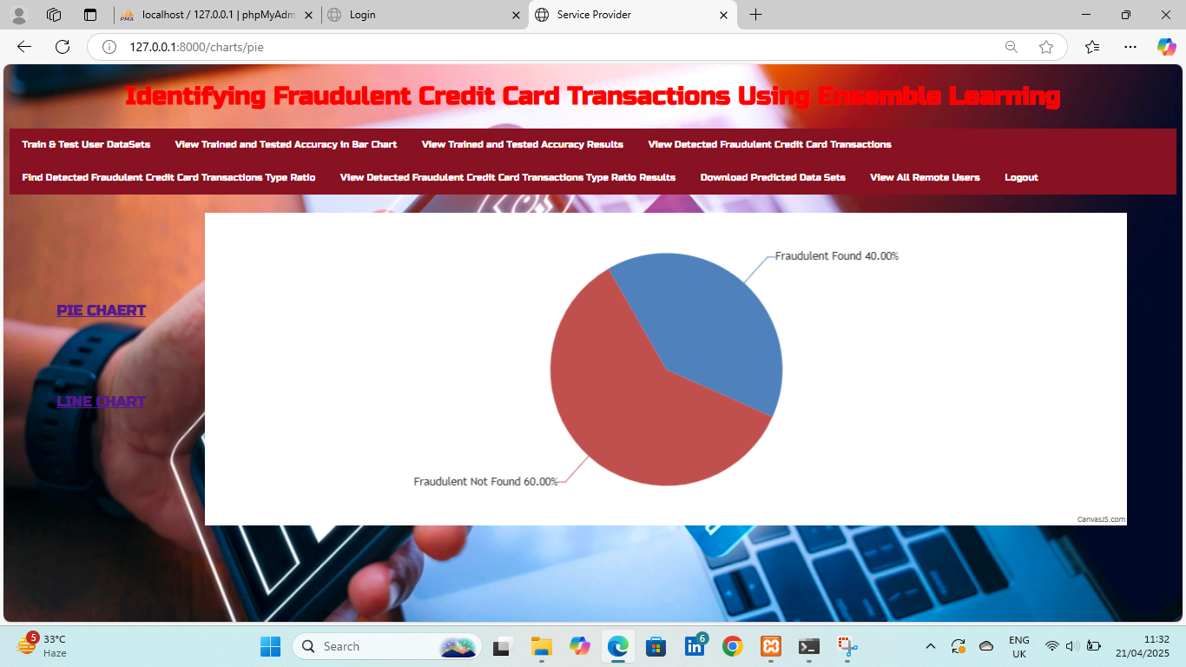
PROJECT SCREENSHOT

Slide 37
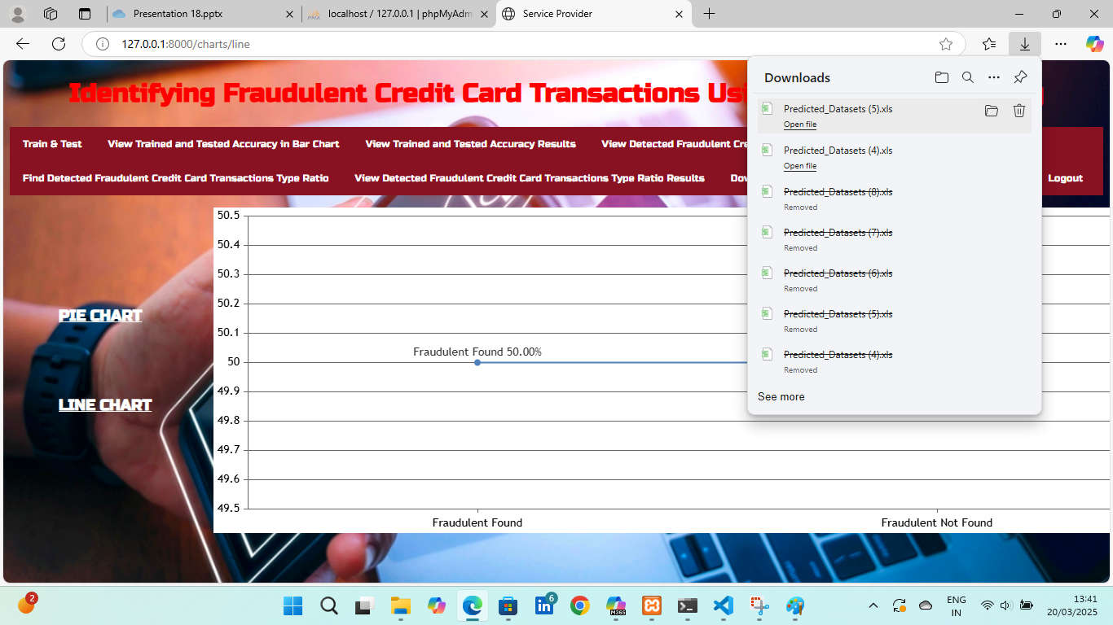
PROJECT SCREENSHOT

Slide 38
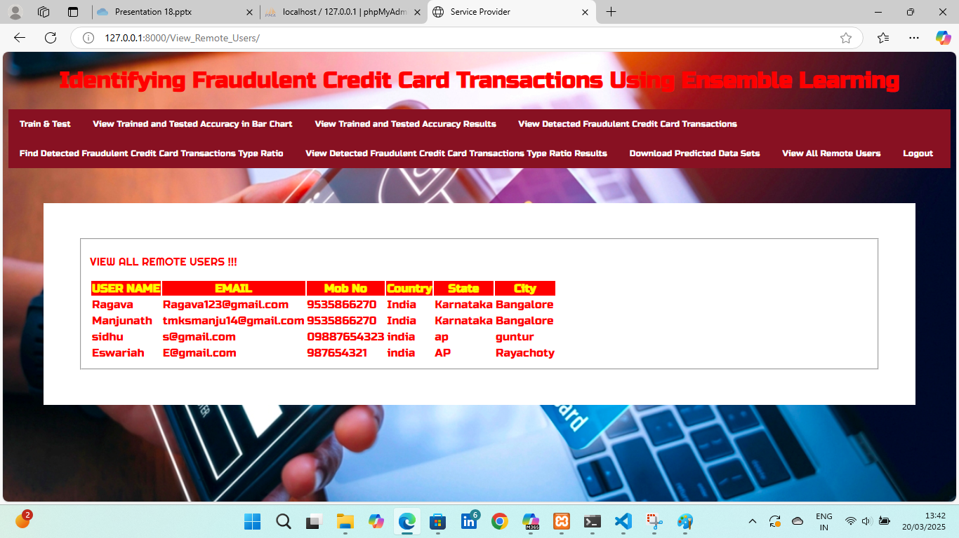
PROJECT SCREENSHOT

Slide 39
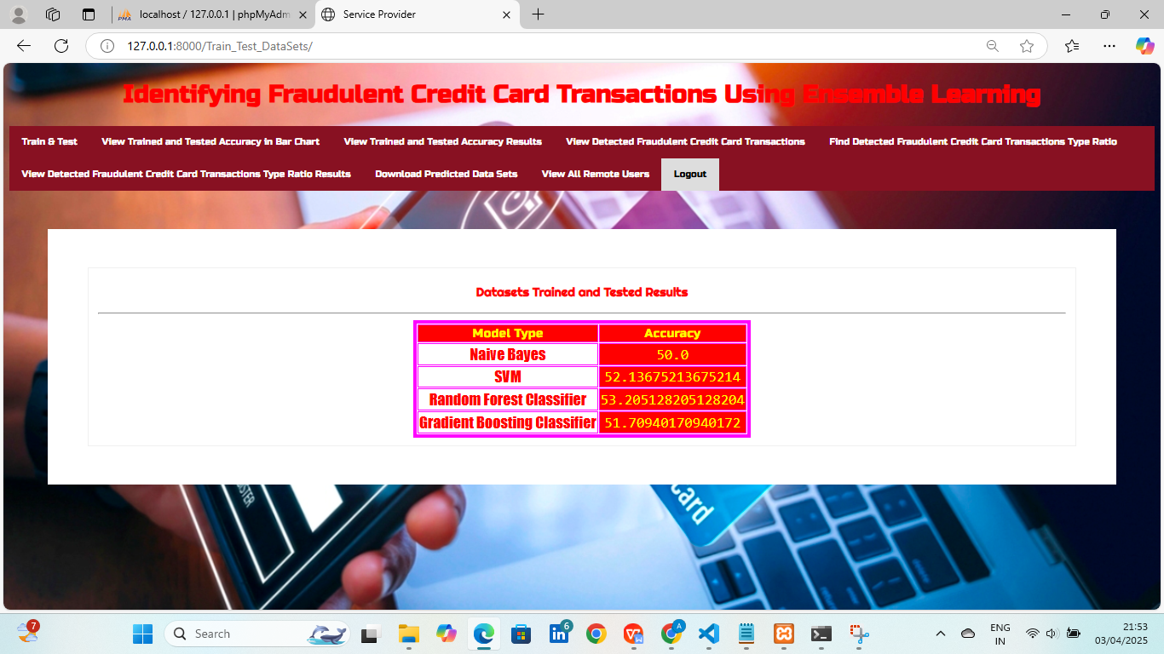
PROJECT SCREENSHOT

Slide 40

CONCLUSION
In this project, we explored the identification of fraudulent credit card transactions using Ensemble Learning techniques. By leveraging multiple machine learning models, including Navie bayes, Random Forest, Gradient Boosting, and SVM, we improved the predictive accuracy and robustness of our fraud detection system.
Our results demonstrated that Ensemble Learning effectively enhances model performance by reducing overfitting.

Slide 41

FUTURE ENHANCEMENT
To further enhance the effectiveness and efficiency of fraud detection using ensemble learning, several improvements can be implemented:
Real-Time Fraud Detection System
Blockchain for Secure Transactions
AI Chatbots for Fraud Alerts and Investigations
AI-Powered Risk Scoring System
With these advancements, fraud detection using Ensemble Learning will become an essential component of financial security, reducing losses and improving customer trust.

Slide 42


